Slide 1

15B11CI412 Operating Systems & System Programming
Introduction
1

Slide 2
COURSE OUTCOMES
CO1:Describe and explain the fundamental components of operating systems and system programming.
CO2:Apply and compare various policies of scheduling in processes and threads in OS.
CO3:Describe and discuss various resource management techniques of operating systems and compare their performances.
CO4:Understand the concept of IPC and describe various process synchronization techniques in OS.
CO5:Discuss the working of IO management and apply various disk scheduling techniques.
CO6:Analyze and report appropriate OS design choices when building real-world systems.

Slide 3
Recommended Reading material
William Stallings, “OPERATING SYSTEMS INTERNALS AND DESIGN PRINCIPLES”.
Andrew S. Tanenbaum, “Operating Systems Design and Implementation”, Third Edition, Prentice Hall Publications 2006
A.S. Tanenbaum, “Modern Operating Systems”, 2nd edition, Prentice Hall India.
A.Silberschatz, P.Galvin, G. Gagne, “Operating systems concepts” Willey international company (sixth edition)

Slide 4
Introduction
What is an operating system?
Operating Systems History
Simple Batch Systems
Multiprogrammed Batch Systems
Time-sharing Systems
Personal Computer Systems
Parallel and Distributed Systems
Real-time Systems
4

Slide 5
What is an Operating System?
An OS is a program that acts an intermediary between the user of a computer and computer hardware.
OS acts as control program as well as resource manager.
Major cost of general purpose computing is software.
OS simplifies and manages the complexity of running application programs efficiently.
5

Slide 6
Computer System Components
Hardware
Provides basic computing resources (CPU, memory, I/O devices).
Operating System
Controls and coordinates the use of hardware among application programs.
Application Programs
Solve computing problems of users (compilers, database systems, video games, business programs such as banking software).
Users
People, machines, other computers
6

Slide 7
Abstract View of System
User 1
User 2
User 3
User n
...
compiler assembler _{Text editor} Database system System and Application Programs
 | Operating System
 |  | Computer Hardware
7

Slide 8
Operating System Views
Resource allocator
to allocate resources (software and hardware) of the computer system and manage them efficiently.
Control program
Controls execution of user programs and operation of I/O devices.
Kernel
The program that executes forever (everything else is an application with respect to the kernel).
8

Slide 9
Goals of an Operating System
Simplify the execution of user programs and make solving user problems easier.
Use computer hardware efficiently.
Allow sharing of hardware and software resources.
Make application software portable.
Provide isolation, security and protection among user programs.
Improve overall system reliability
error confinement, fault tolerance, reconfiguration.
9

Slide 10
Why should I study Operating Systems?
Need to understand interaction between the hardware and applications
New applications, new hardware..
Inherent aspect of society today
Need to understand basic principles in the design of computer systems
efficient resource management, security, flexibility
Increasing need for specialized operating systems
e.g. embedded operating systems for devices - cell phones, sensors and controllers
real-time operating systems - aircraft control, multimedia services
10

Slide 11
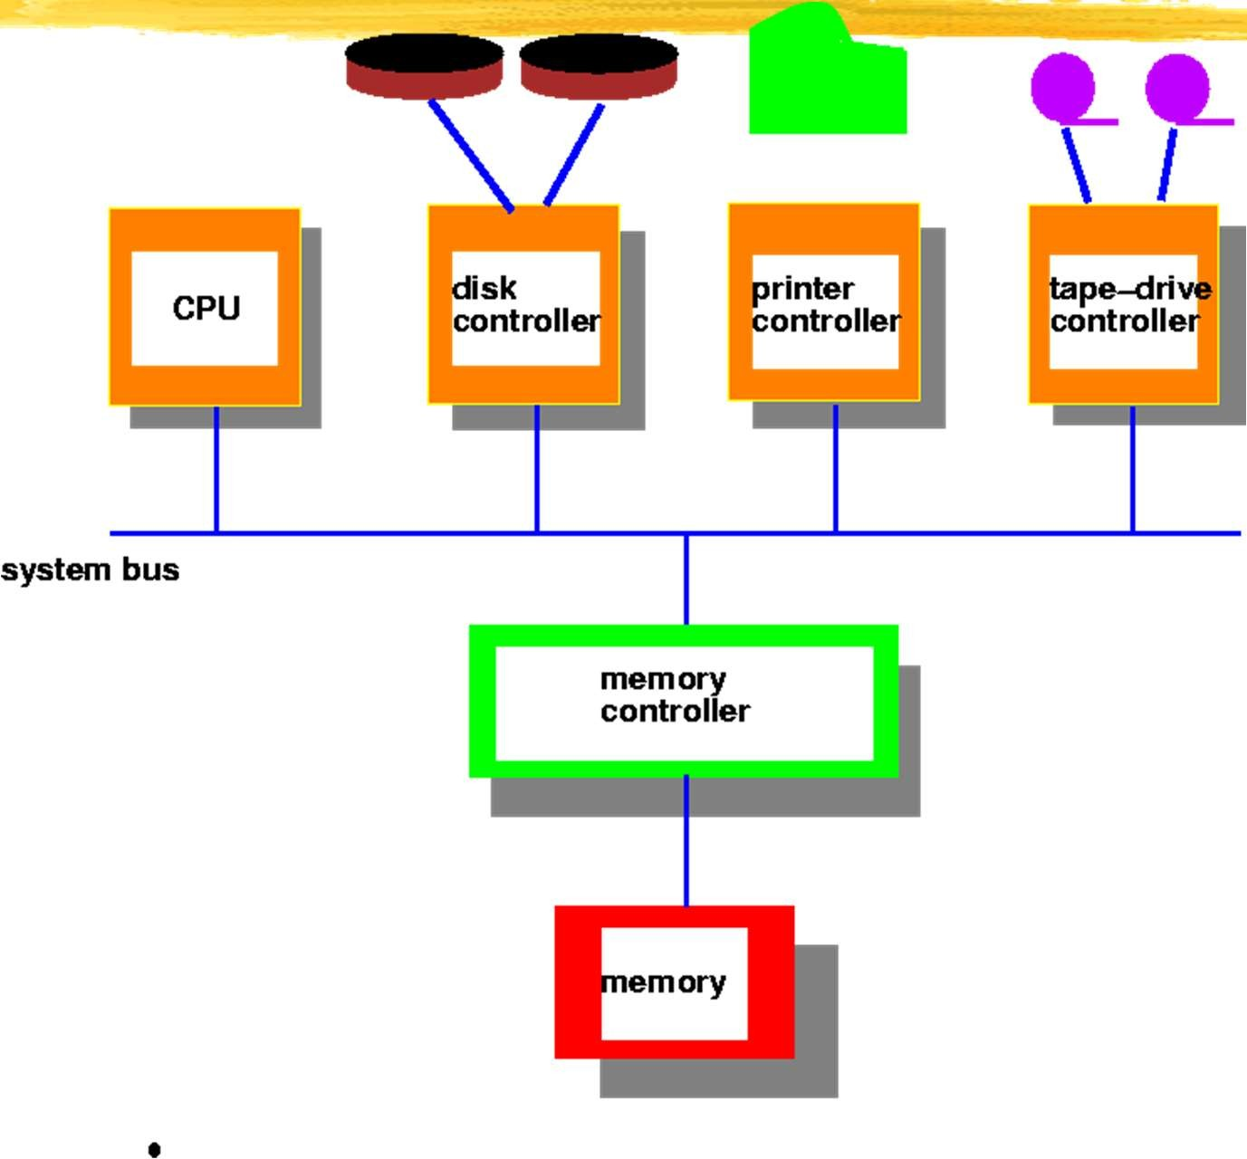
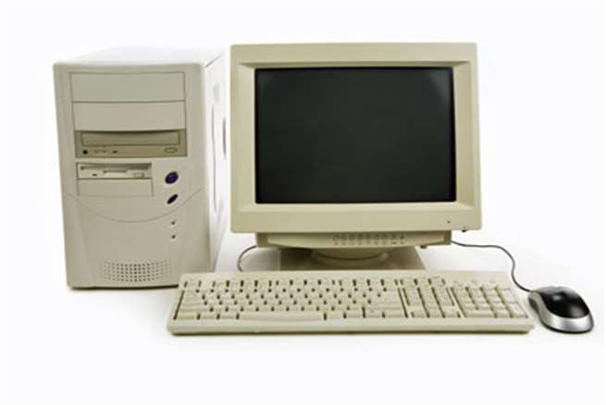
Computer System Architecture (traditional)

Slide 12
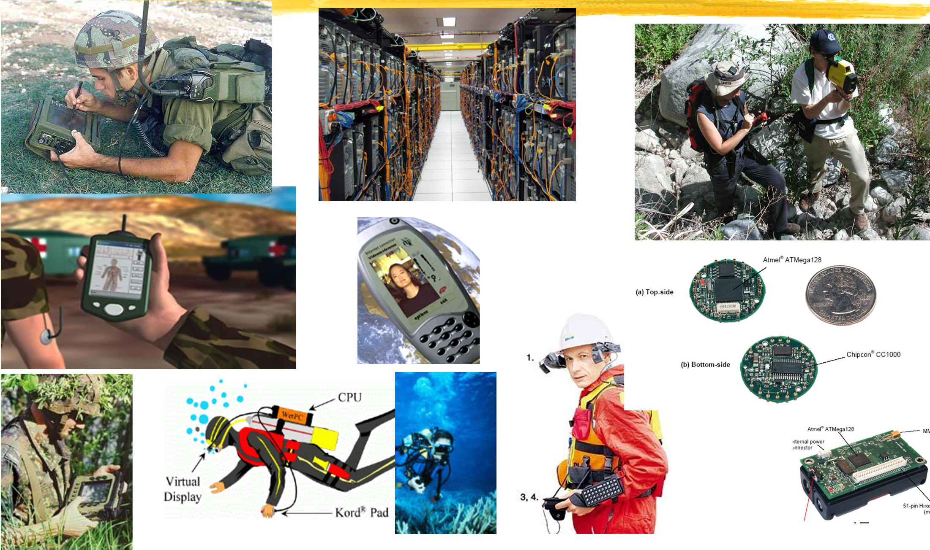
Systems Today
12

Slide 13
Operating System Spectrum
Monitors and Small Kernels
special purpose and embedded systems, real-time systems
Batch and multiprogramming
Timesharing
workstations, servers, minicomputers, timeframes
Transaction systems
Personal Computing Systems
Mobile Platforms, devices (of all sizes)
9

Slide 14
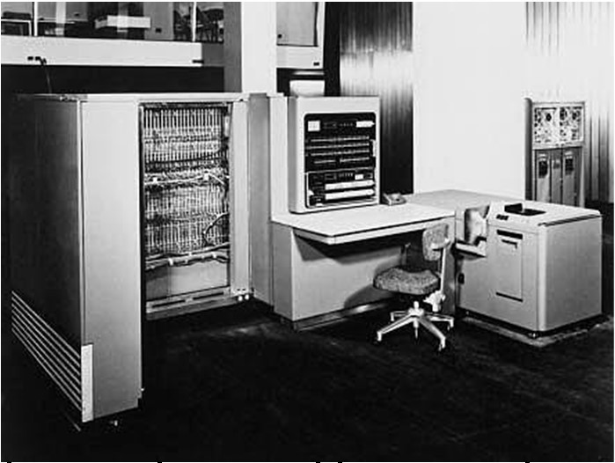
Early Systems - Bare Machine (1950s)
Hardware – expensive ; Human – cheap
Structure
Large machines run from console
Single user system
Programmer/User as operator
Paper tape or punched cards
Early software
From John Ousterhout slides
Assemblers, compilers, linkers, loaders, device drivers, libraries of common subroutines.
Secure execution
Inefficient use of expensive resources
Low CPU utilization, high setup time.
10

Slide 15
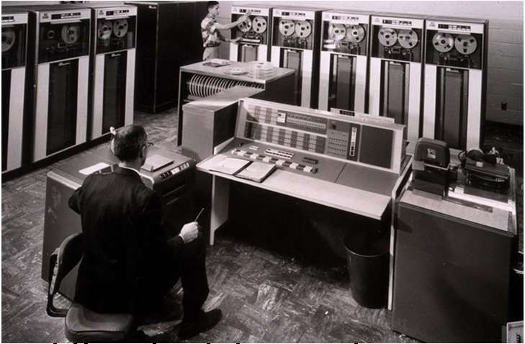
Simple Batch Systems (1960’s)
Reduce setup time by batching jobs with similar requirements.
Add a card reader, Hire an operator
User is NOT the operator
Automatic job sequencing
Forms a rudimentary OS.
Resident Monitor
Holds initial control, control transfers to job and then back to monitor.
Problem
Need to distinguish job from job and data from program.
From John Ousterhout slides
11

Slide 16
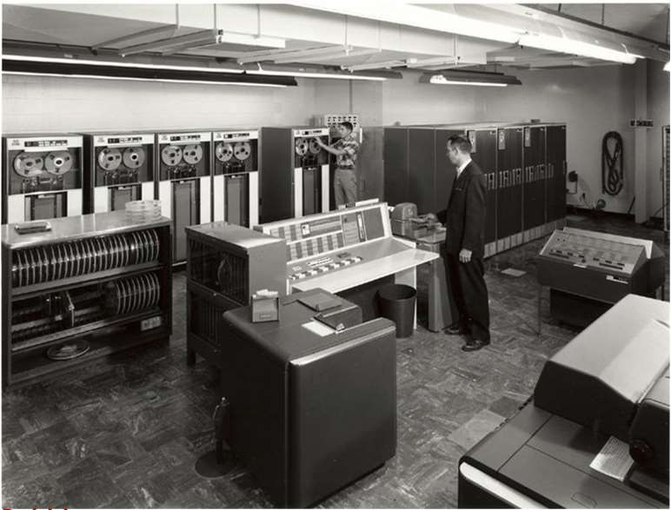
Supervisor/Operator Control
Secure monitor that controls job processing
Special cards indicate what to do.
User program prevented from performing I/O
Separate user from computer
User submits card deck
cards put on tape
tape processed by operator
output written to tape
tape printed on printer
Problems
IBM 7094
Long turnaround time - up to 2 DAYS!!!
Low CPU utilization
From John Ousterhout slides
I/O and CPU could not overlap; slow mechanical devices.
12

Slide 17
Batch Systems - Issues
Solutions to speed up I/O:
Offline Processing
load jobs into memory from tapes, card reading and line printing are done offline.
Spooling
Use disk (random access device) as large storage for reading as many input files as possible and storing output files until output devices are ready to accept them.
Allows overlap - I/O of one job with computation of another.
Introduces notion of a job pool that allows OS choose next job to run so as to increase CPU utilization.
13

Slide 18
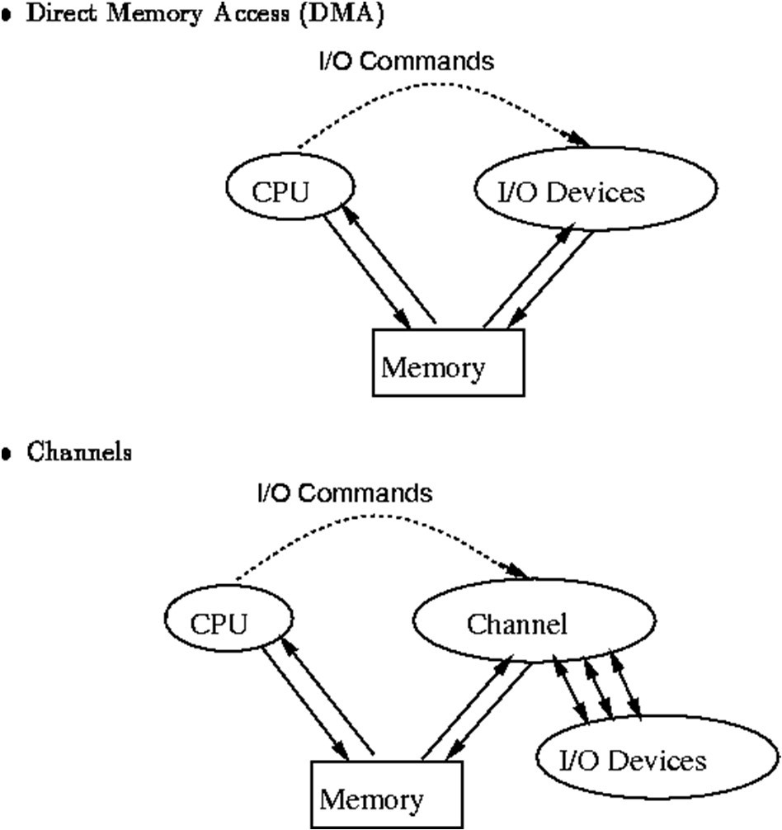
Speeding up I/O
14

Slide 19
Batch Systems - I/O completion
How do we know that I/O is complete?
Polling:
Device sets a flag when it is busy.
Program tests the flag in a loop waiting for completion of I/O.
Interrupts:
On completion of I/O, device forces CPU to jump to a specific instruction address that contains the interrupt service routine.
After the interrupt has been processed, CPU returns to code it was executing prior to servicing the interrupt.
15

Slide 20
Multiprogramming
Use interrupts to run multiple programs simultaneously
When a program performs I/O, instead of polling, execute another program till interrupt is received.
Requires secure memory, I/O for each program.
Requires intervention if program loops indefinitely.
Requires CPU scheduling to choose the next job to run.
16

Slide 21
Timesharing
Hardware – getting cheaper; Human – getting expensive
Programs queued for execution in FIFO order.
Like multiprogramming, but timer device interrupts after a quantum (timeslice).
Interrupted program is returned to end of FIFO
Next program is taken from head of FIFO
Control card interpreter replaced by command language interpreter.
17

Slide 22
Timesharing (cont.)
Interactive (action/response)
when OS finishes execution of one command, it seeks the next control statement from user.
File systems
online filesystem is required for users to access data and code.
Virtual memory
Job is swapped in and out of memory to disk.
18

Slide 23
Personal Computing Systems
Hardware – cheap ; Human – expensive
Single user systems, portable.
I/O devices - keyboards, mice, display screens, small printers.
Laptops and palmtops, Smart cards, Wireless devices.
Single user systems may not need advanced CPU utilization or protection features.
Advantages:
user convenience, responsiveness, ubiquitous
19

Slide 24
Parallel Systems
Multiprocessor systems with more than one CPU in close communication.
Improved Throughput, economical, increased reliability.
Kinds:
Vector and pipelined
Symmetric and asymmetric multiprocessing
Distributed memory vs. shared memory
Programming models:
Tightly coupled vs. loosely coupled ,message-based vs. shared variable
20

Slide 25
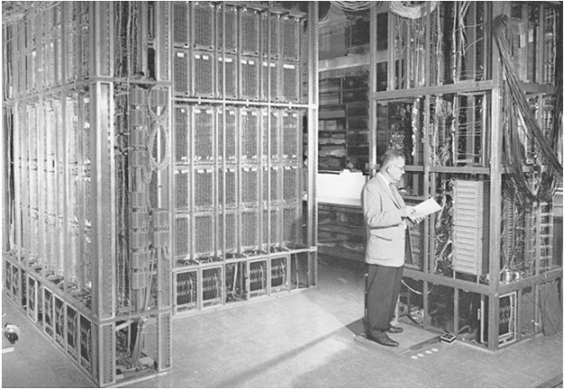
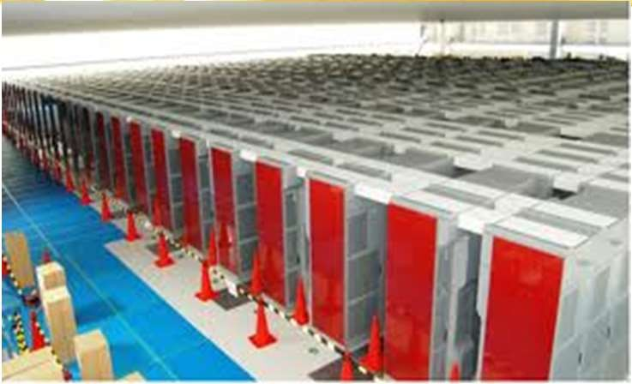
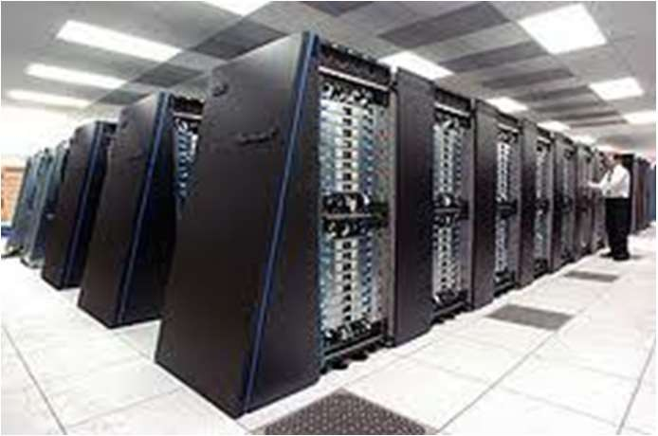
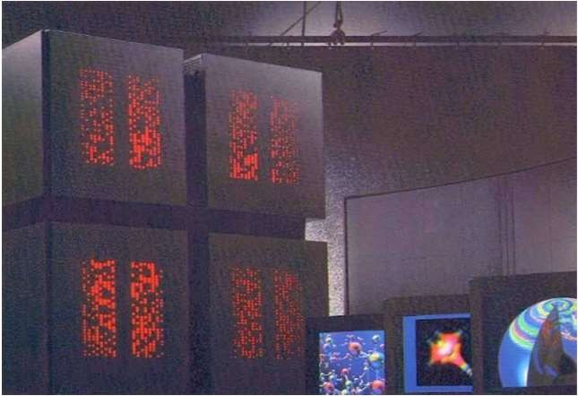
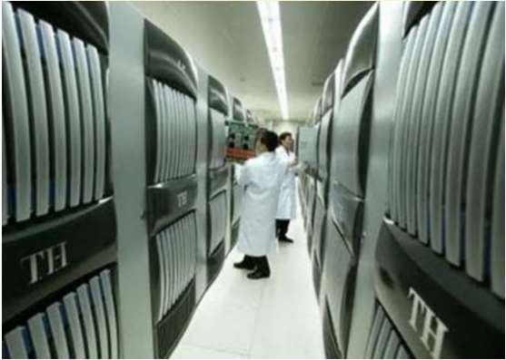
Parallel Computing Systems
ILLIAC 2 (UIllinois)
Climate modeling, earthquake simulations, genome analysis, protein folding, nuclear fusion research, …..
K-computer(Japan)
Tianhe-1(China)
IBM Blue Gene
Connection Machine (MIT)
21

Slide 26
Distributed Systems
Hardware – very cheap ; Human – very expensive
Distribute computation among many processors.
Loosely coupled -
no shared memory, various communication lines
client/server architectures
Advantages:
resource sharing
computation speed-up
reliability
communication - e.g. email
Applications - digital libraries, digital multimedia
22

Slide 27
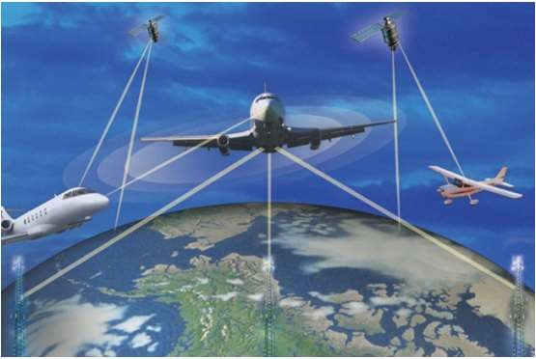
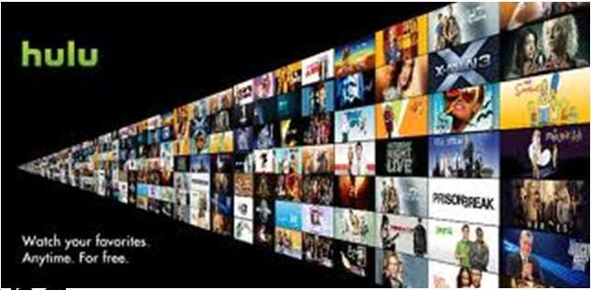
Real-time systems
Correct system function depends on timeliness
Feedback/control loops
Sensors and actuators
Hard real-time systems -
Failure if response time too long.
Secondary storage is limited
Soft real-time systems -
Less accurate if response time is too long.
Useful in applications such as multimedia, virtual reality.
23

Slide 28
Storage Structure
Main memory - only large storage media that the CPU can access directly.
Secondary storage - has large nonvolatile storage capacity.
Magnetic disks - rigid metal or glass platters covered with magnetic recording material.
Disk surface is logically divided into tracks, subdivided into sectors.
Disk controller determines logical interaction between device and computer.
28

Slide 29
Storage Hierarchy
Storage systems are organized in a hierarchy based on
Speed
Cost
Volatility
Caching - process of copying information into faster storage system; main memory can be viewed as fast cache for secondary storage.

Slide 30
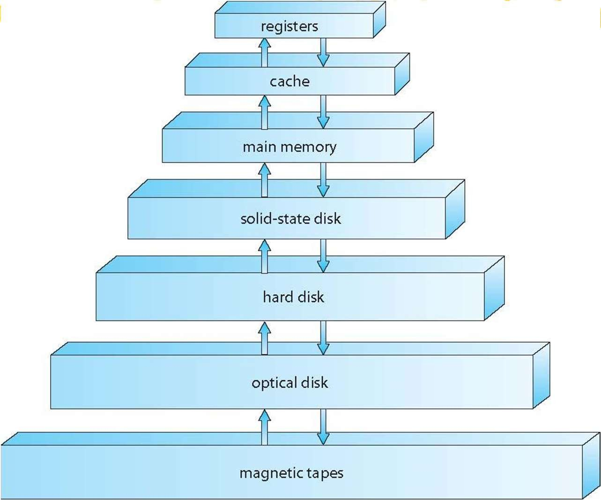
Storage Device Hierarchy

Slide 31
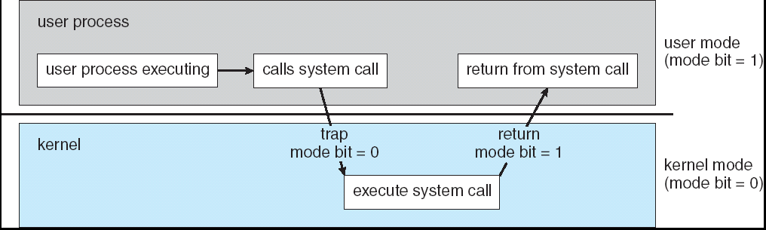
System Calls
User code can issue a syscall, which causes a trap
Kernel handles the syscall
31
Image Source : Operating Systems Concepts By Silberschatz & Galvin

Slide 32
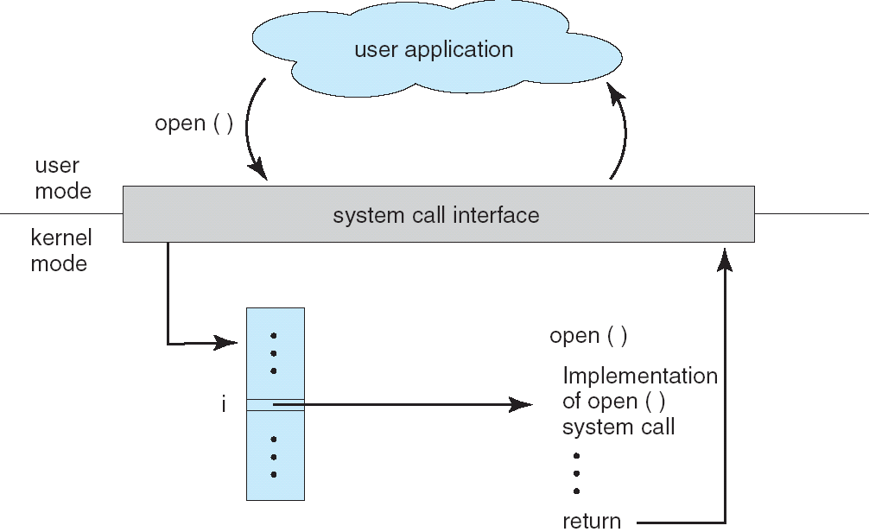
System Calls
Interface between applications and the OS.
Application uses an assembly instruction to trap into the kernel
Some higher level languages provide wrappers for system calls (e.g., C)
System calls pass parameters between an and OS via registers or memory, memory tables or stack.
Linux has about 300 system calls
read(), write(), open(), close(), fork(), exec(), ioctl(),…..
32
Image Source : Operating Systems Concepts By Silberschatz & Galvin

Slide 33
OS Task: Process Management
Process - fundamental concept in OS
Process is an instance of a program in execution.
Process needs resources - CPU time, memory, files/data and I/O devices.
OS is responsible for the following process management activities.
Process creation and deletion
Process suspension and resumption
Process synchronization and interprocess communication
Process interactions - deadlock detection, avoidance and correction

Slide 34
OS Task: Memory Management
Main Memory is an array of addressable words or bytes that is quickly accessible.
Main Memory is volatile.
OS is responsible for:
Allocate and deallocate memory to processes.
Managing multiple processes within memory - keep track of which parts of memory are used by which processes. Manage the sharing of memory between processes.
Determining which processes to load when memory becomes available.
26

Slide 35
OS Task: Secondary Storage and I/O Management
Since primary storage (i.e., main memory) is expensive and volatile, secondary storage is required for backup.
Disk is the primary form of secondary storage.
OS performs storage allocation, free-space management, etc.
I/O system in the OS consists of
Device driver interface that abstracts device details
Drivers for specific hardware devices

Slide 36
OS Task: File System Management
File is a collection of related information - represents programs and data.
OS is responsible for
File creation and deletion
Directory creation and deletion
Supporting primitives for file/directory manipulation.
Mapping files to disks (secondary storage).

Slide 37
OS Task: Protection and Security
Protection mechanisms control access of processes to user and system resources.
Protection mechanisms must:
Distinguish between authorized and unauthorized use.
Specify access controls to be imposed on use.
Provide mechanisms for enforcement of access control.

Slide 38
Operating Systems: How are they organized?
Simple

Slide 39
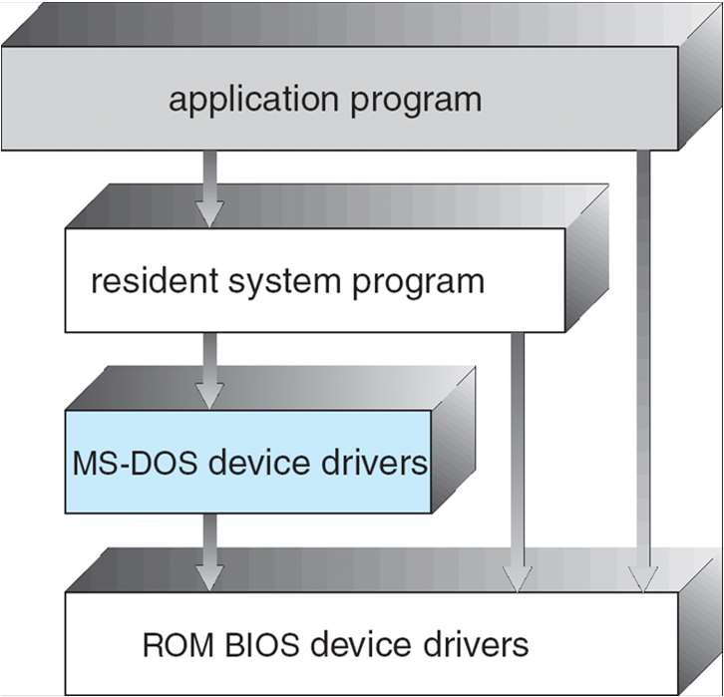
OS Structure - Simple Approach
MS-DOS - provides a lot of functionality in little space.
Not divided into modules, Interfaces and levels of functionality are not well separated

Slide 40
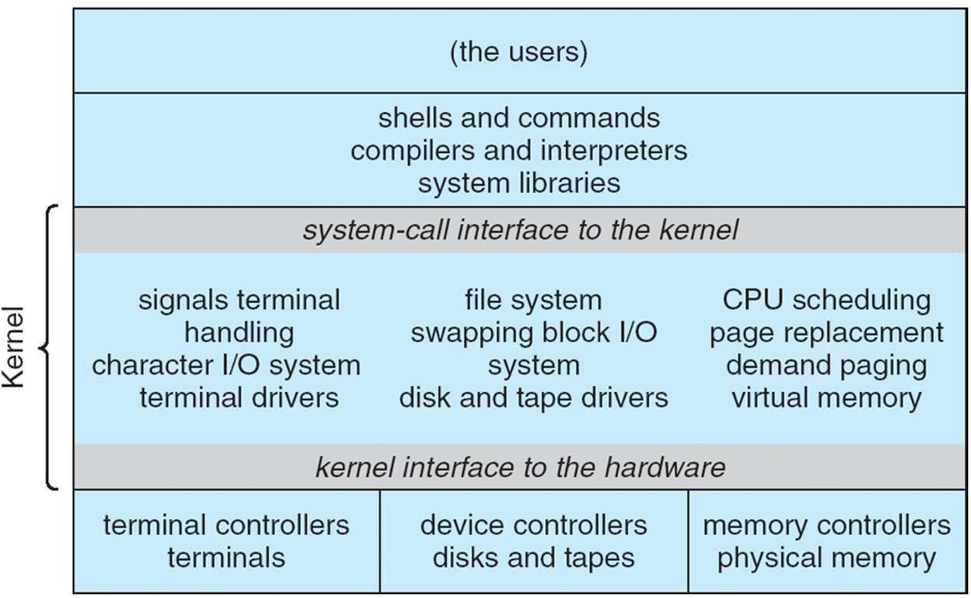
Original UNIX System Structure
Limited structuring, has 2 separable parts
Systems programs
Kernel
everything below system call interface and above physical hardware.
Filesystem, CPU scheduling, memory management

Slide 41
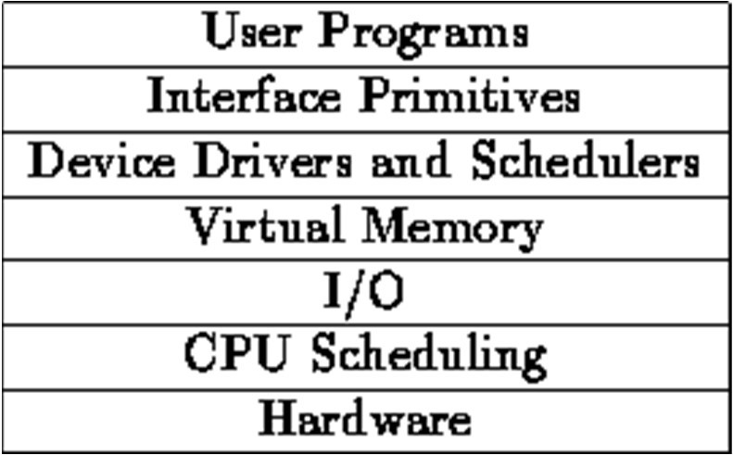
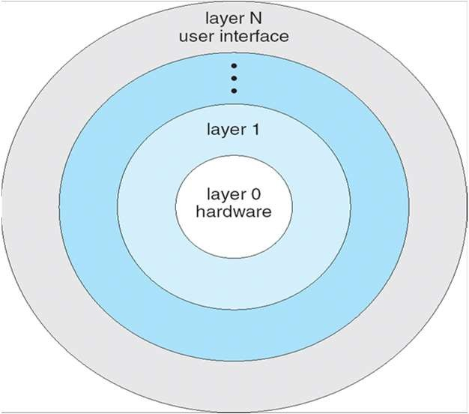
Layered OS Structure
OS divided into number of layers - bottom layer is hardware, highest layer is the user interface.
Each layer uses functions and services of only lower- level layers.
THE Operating System and Linux Kernel has successive layers of abstraction.

Slide 42
Monolithic vs. Microkernel OS
Monolithic OSes have large kernels with a lot of components
Linux, Windows, Mac
Microkernels moves as much from the kernel into “user” space
Small core OS components running at kernel level
OS Services built from many independent user-level processes
Communication between modules with message passing
Benefits:
Easier to extend a microkernel
Easier to port OS to new architectures
More reliable and more secure (less code is running in kernel mode)
Detriments:
Performance overhead severe for naïve implementation

Slide 43
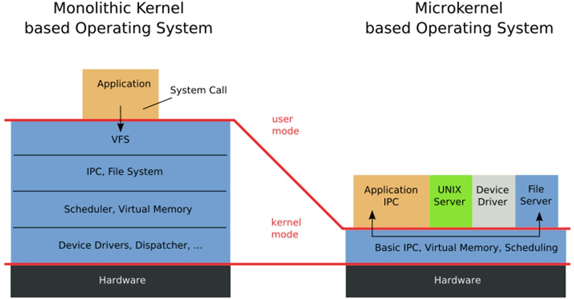
A microkernel OS
Slide adapted from h ttp://web.cecs.pdx.edu/~walpole/class/cs533/fall2015/home.html
34

Slide 44
Virtual Machines
Physical Machine
Application
OS
Hardware
35

Slide 45
Virtual Machines
Virtual Machine 1
Virtual Machine 2
Virtual Machine 3
 | Application |  |  |  | Application |  |  |  | Application
 | OS |  |  |  | OS |  |  |  | OS
Virtual Machine Monitor (VMM) (aka Hypervisor)
Hardware

Slide 46
Virtual Machines
Use cases
Resource configuration
Running multiple OSes, either the same or different OSes
Run existing OS binaries on different architecture

